Slide 1
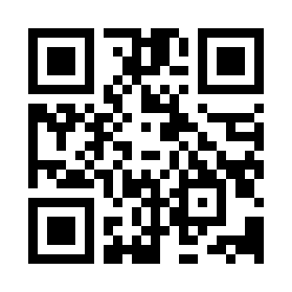

Software Risk Management Quiz
https://bit.ly/3SA9Qri

